Slide 1
Introduction to CLI
HILT 2019

Slide 2
Right now we will cover: … and will gesture toward:
What is the “command line interface”?
How do I use it?
WHY would I use it?

Slide 3
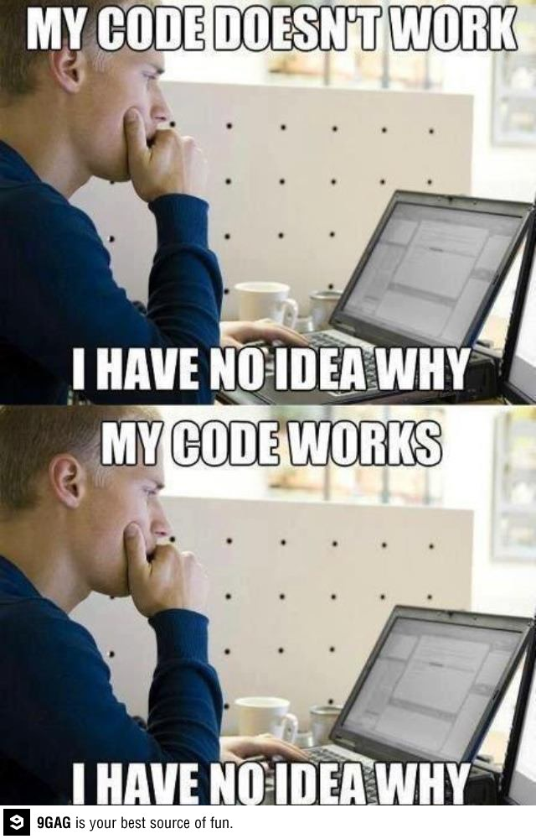
Programming Rules
Expect confusion.
Embrace it!
Ask questions.
Look online!

Slide 5
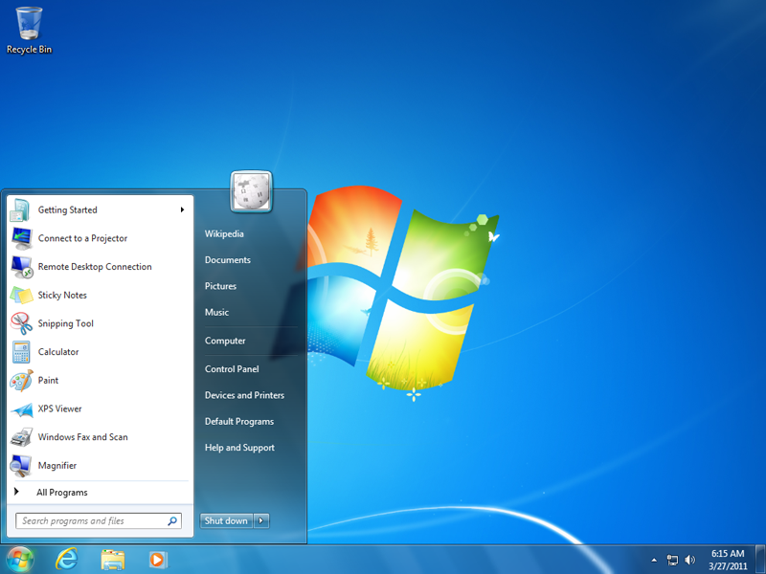
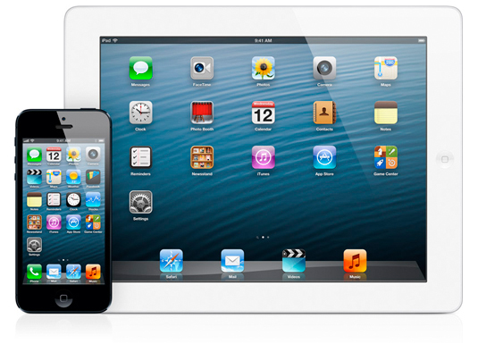
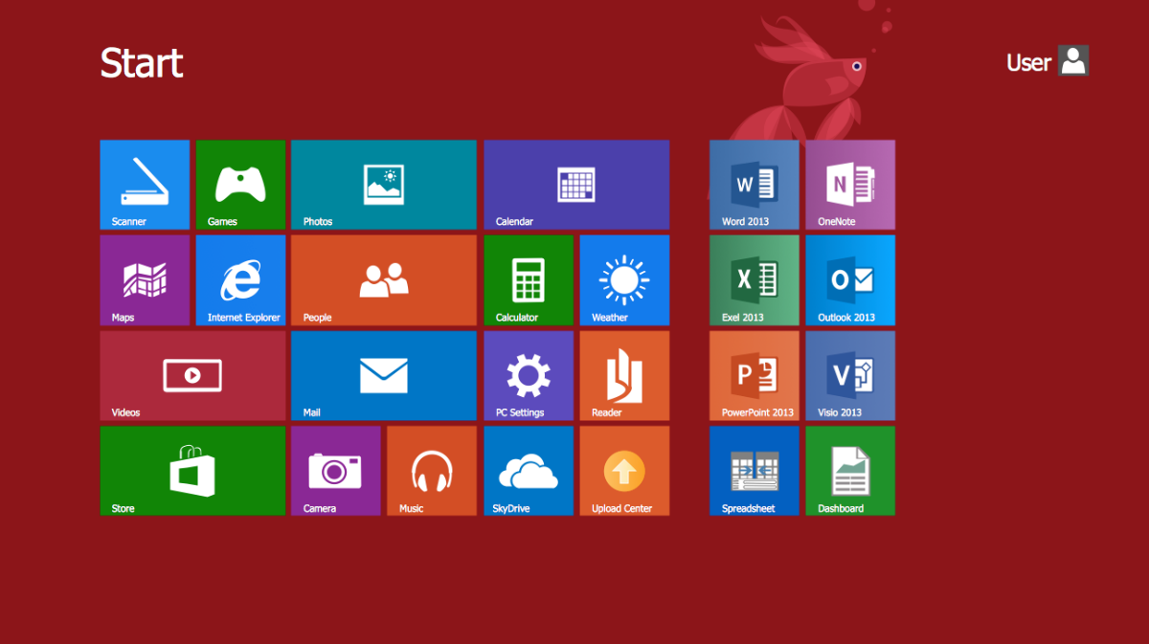
GUI (Graphical User Interface)

Slide 6
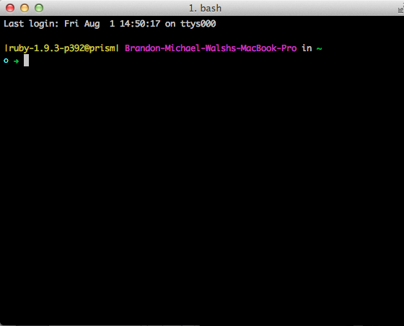
CLI (Command Line Interface)

Slide 7
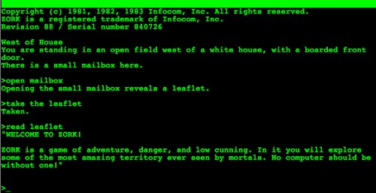
From Zork, 1981

Slide 8
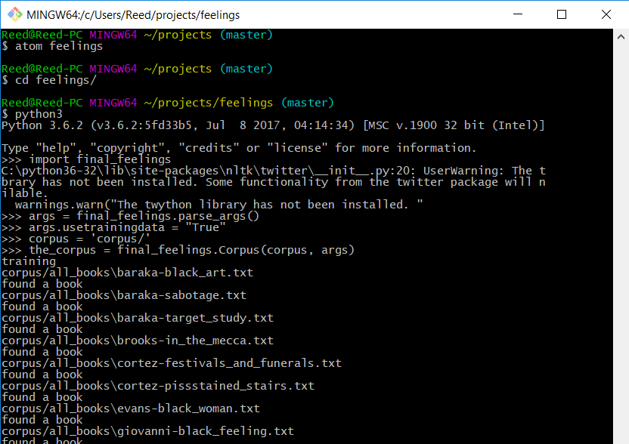
When would I use the CLI in a DH project?

Slide 9
Commands We’ll Learn
Command Structure
cd – change directory
ls – list directory contents
pwd – print working directory
touch – create new file
rm – remove file (careful!)
mkdir – make directory
cp – copy file
mv – move file
man – help page
$ command parameters
$ mkdir new_project
$ touch index.html
command = what to do
parameters = how or to what

Slide 10
You are a programmer!

Slide 11
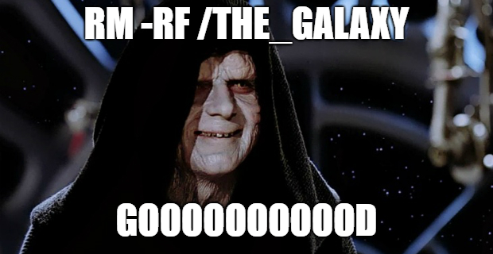
With great power….

Slide 12
Getting Help for the NEXT LEVEL
Learn Code the Hard way
http://cli.learncodethehardway.org/
Codecademy
https://www.codecademy.com/learn/learn-the-command-line
CLI Quiz
https://github.com/bmw9t/command_line_quiz/

Slide 13
Introduction to Git
HILT 2019

Slide 14
Right now we will cover: … and will gesture toward:
What is the “version controlling”?
What is “git”?
How do I use it?
WHY would I use it?

Slide 15
Version Controlling
Save TONS of different versions of project over time.
Can recover ANY of those iterations.
Nothing is ever lost.
The date, time, and extent of every change is logged (so is the person who made the changes).

Slide 16
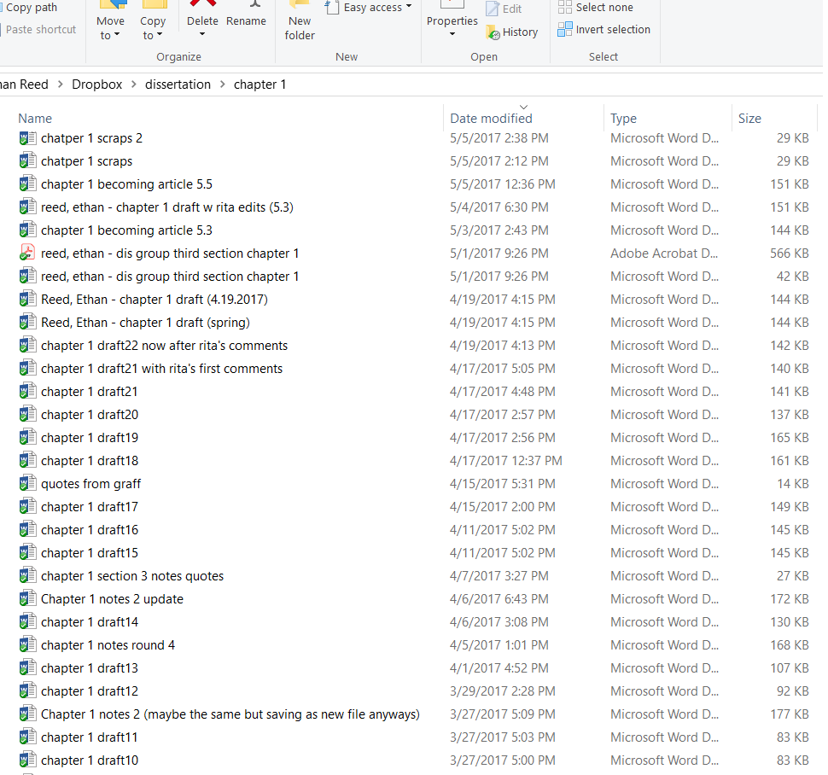
:(

Slide 17
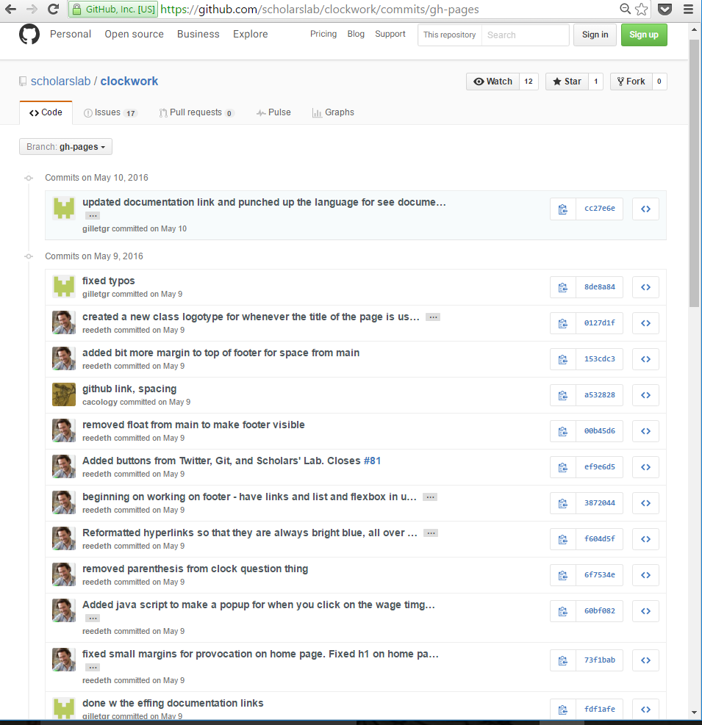
:)

Slide 18
Git
Distributed Version Control System.
Each clone gets the entire project history.
Code exists, in full, everywhere.
Allows easy collaboration via GitHub.

Slide 19
Workflow with Commands
1. Modify a file (in a text editor).
2. Add that file to the staging area.
$ git add file_name
3. Commit it to the repository (with a message).
$ git commit –m “Increased the font size of the title”
4. Start process over.
http://rogerdudler.github.io/git-guide/files/git_cheat_sheet.pdf

Slide 20
Commands We’ll Learn
git init
git status
git add
git commit –m
git push
git branch
git checkout
git merge
git diff
git log

Slide 21
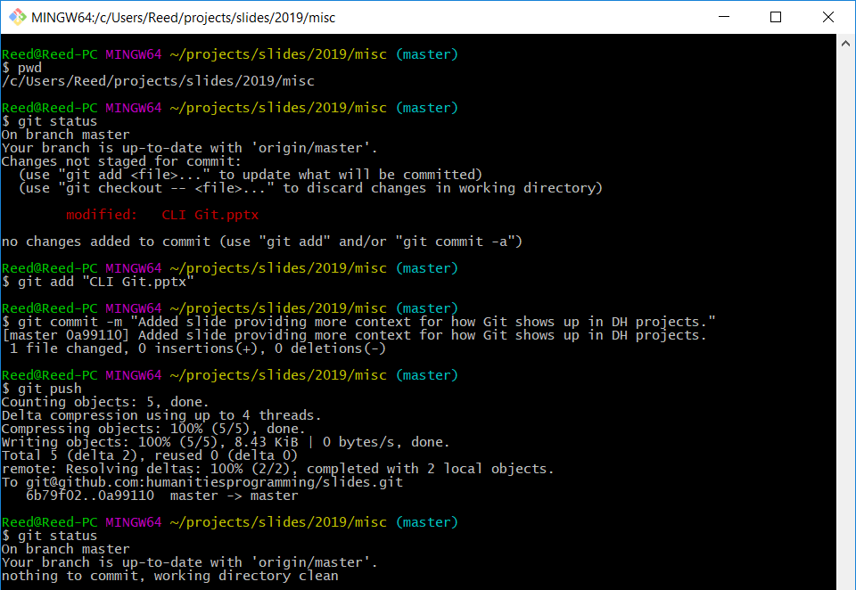
When would I use Git in a DH project?

Slide 22
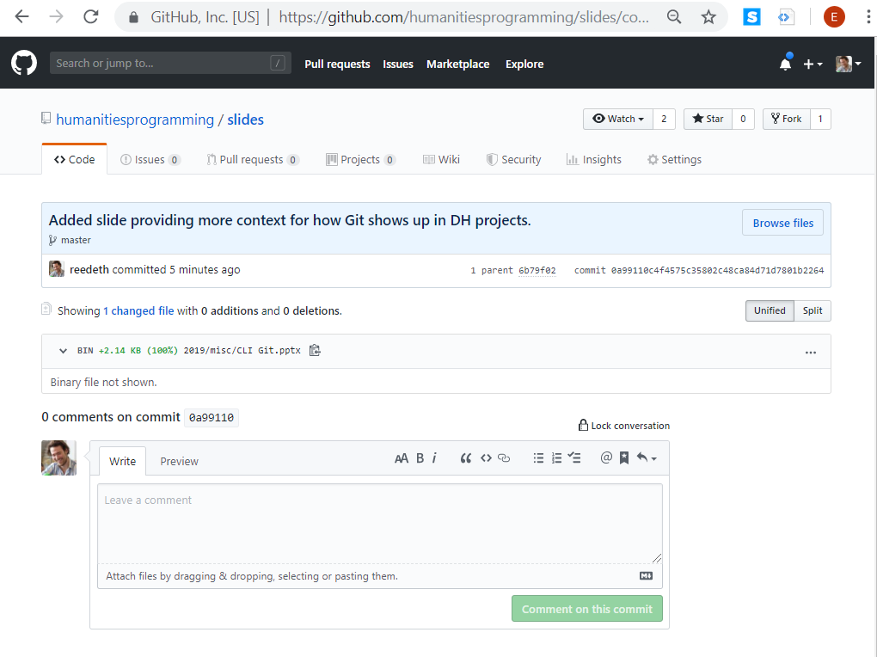
When would I use Git in a DH project?

Slide 23
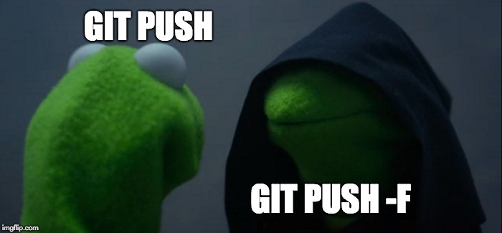

Slide 24
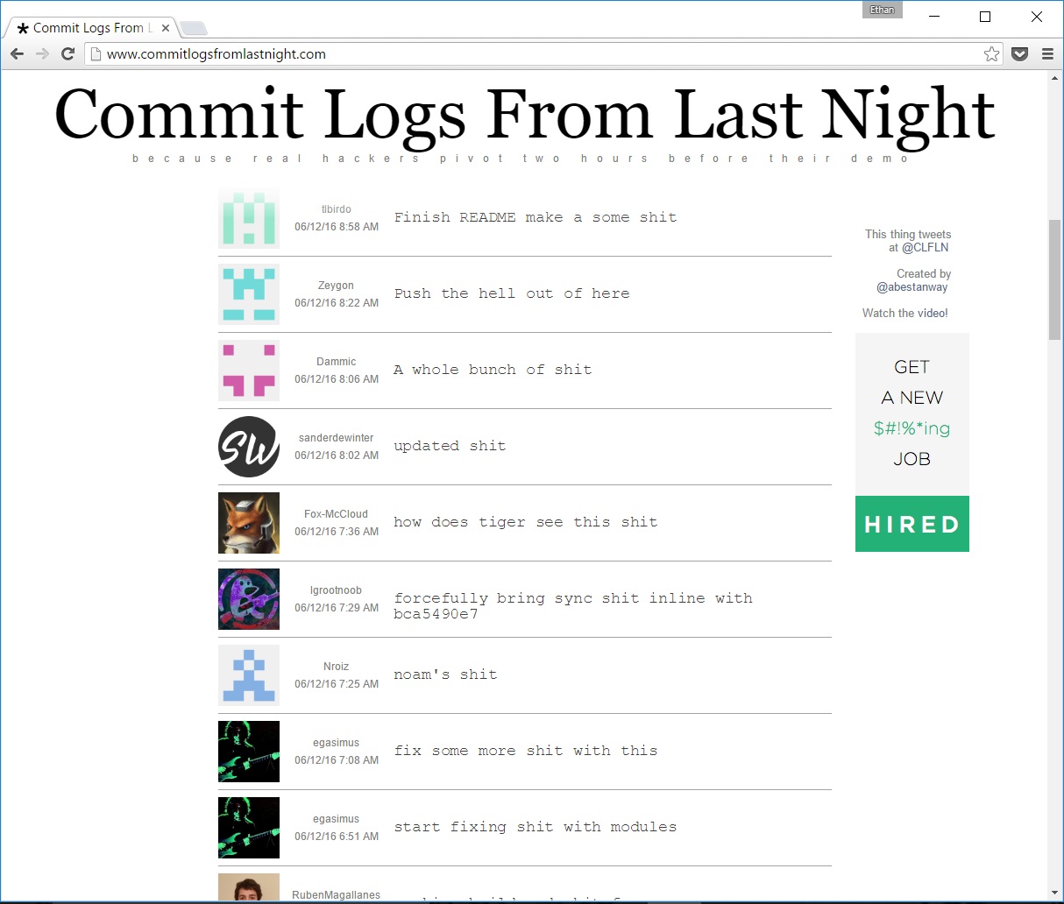
The Importance of Informative Commit Messages!

Slide 25
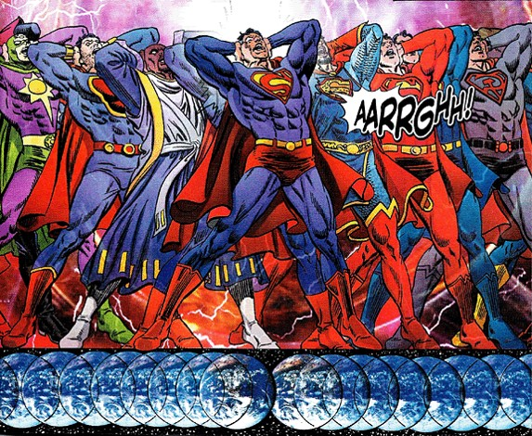
The Parallel Universes of Git Branches & Merges ---as easy as comic book storylines!!

Slide 26
Getting Help for the NEXT LEVEL
Git tutorials and documentation
https://www.atlassian.com/git/tutorials/
https://www.codecademy.com/learn/learn-git
https://git-scm.com/doc
Git for ages 4 and up
https://youtu.be/1ffBJ4sVUb4
GitHub
https://github.com/
http://rogerdudler.github.io/git-guide/
https://guides.github.com/

